Slide 1
Lecture 17
AC Circuit Analysis (2)
Hung-yi Lee

Slide 2
Textbook
AC Circuit Analysis as Resistive Circuits
  Chapter 6.3, Chapter 6.5 (out of the scope)
Fourier Series for Circuit Analysis
Resonance
  Chapter 6.4 (out of the scope)
Oscillator
  Example 9.7 and 6.10

Slide 3
Systematic Analysis for AC Steady State

Slide 4
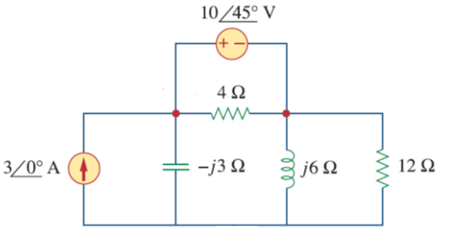

Example – Node Analysis

Slide 5
Example – Node Analysis
Supernode

Slide 6
Example – Node Analysis
Supernode

Slide 7
Thevenin and Norton Theorem for AC Steady State

Slide 8
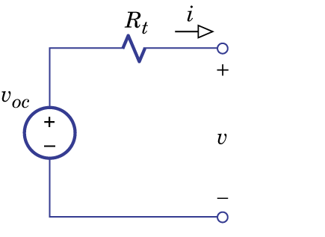
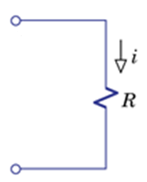
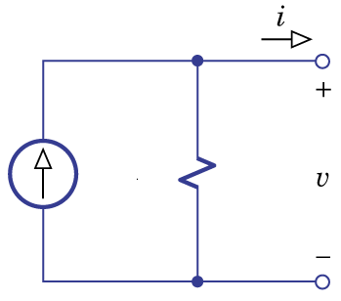
Thevenin & Norton Theorem
DC circuit
Thevenin
Theorem
Two
Terminal
Network
Norton
Theorem

Slide 9
Thevenin & Norton Theorem
DC circuit
  Find the Thevenin parameters
Suppress Sources
Two
Terminal
Network
Two
Terminal
Network
Two
Terminal
Network

Slide 10
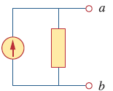
Thevenin & Norton Theorem
AC steady state
Thevenin
Theorem
Two
Terminal
Network
Norton
Theorem

Slide 11
Thevenin & Norton Theorem
AC steady state
  Find the Thevenin parameters
Suppress Sources
Two
Terminal
Network
Two
Terminal
Network
Two
Terminal
Network

Slide 12
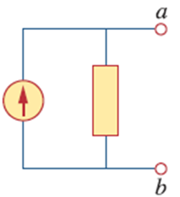

Example - Norton Theorem
Obtain I_{o} by Norton Theorem

Slide 13
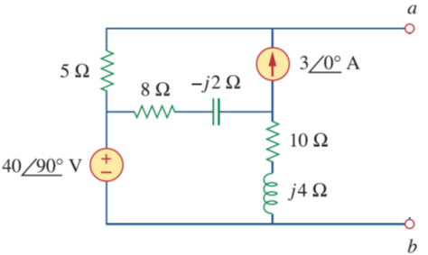
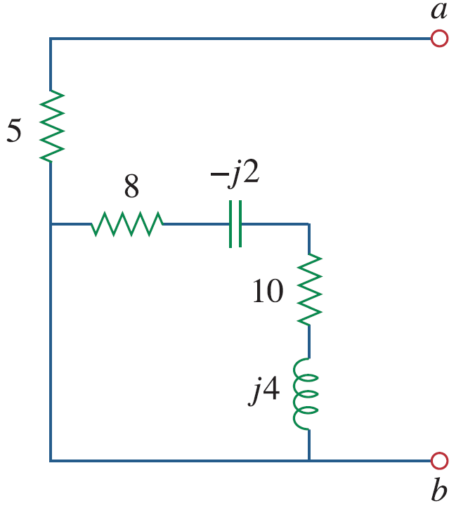
Example - Norton Theorem
Obtain I_{o} by Norton Theorem
  Find Z_{t}
Suppress Sources
Two-terminal Network

Slide 14

Example - Norton Theorem
Obtain I_{o} by Norton Theorem
  Find
Two-terminal Network

Slide 15
Example - Norton Theorem
Obtain I_{o} by Norton Theorem
Notes:
Can not go back to “cos”

Slide 16
Superposition for AC Steady State

Slide 17
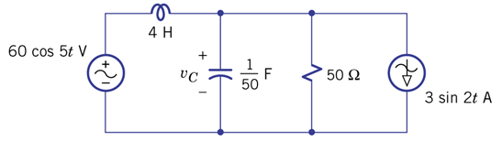
AC Superposition – Example 6.17
Find v_{c}
However, what is the value of ω?

Slide 18
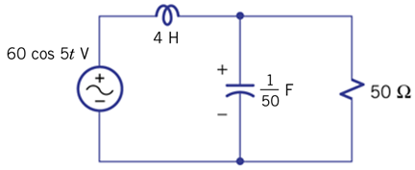
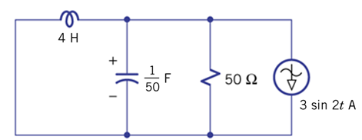
AC Superposition – Example 6.17
Superposition Principle

Slide 19
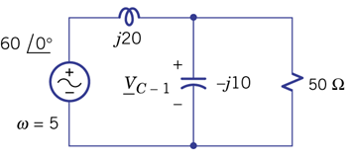
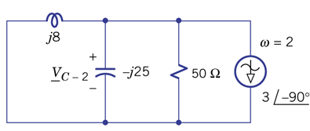
AC Superposition – Example 6.17
The same element has different impedances.

Slide 20
AC Superposition – Example 6.17

Slide 21
Fourier Series for Circuit Analysis
Notes:
Reference: http://www.thefouriertransform.com/series/circuitExample.php

Slide 22
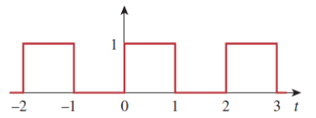
Beyond Sinusoids
1. Fourier Series: periodic function is a linear combination of sinusoids
2. Superposition: find the steady state of individual sinusoids, and then sum them together

Slide 23
Fourier Series
Periodic Function: f(t) = f(t+nT)
  Period: T
  Frequency: f₀ = 1/T
  Circular Frequency: ω₀ = 2πf₀ = 2π/T
Fourier Series:
You will learn how to find a₀, a_{n} and b_{n} in other courses.
Notes:
Finite dis
Finite max & min
Finite integrate

Slide 24
Fourier Series

Slide 25
Fourier Series

Slide 26
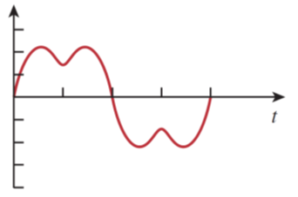
Fourier Series

Slide 27
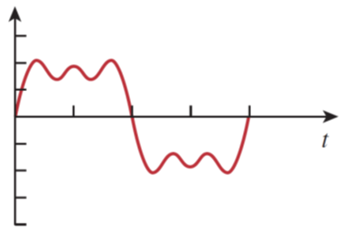
Fourier Series

Slide 28
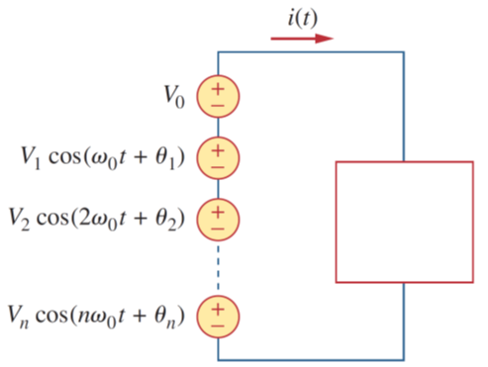
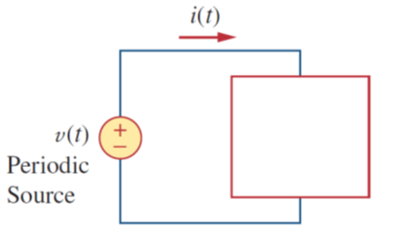
Network
Network

Slide 29
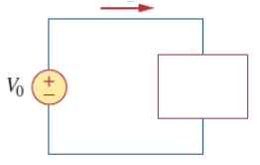
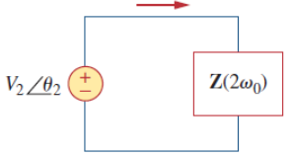
Network
=
Network
……
Capacitor = Open
Inductor = Short

Slide 30
Example

Slide 31
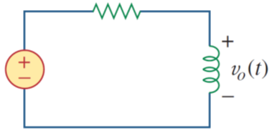
Example

Slide 32
Example

Slide 33
Example
Notes:
P1684

Slide 34
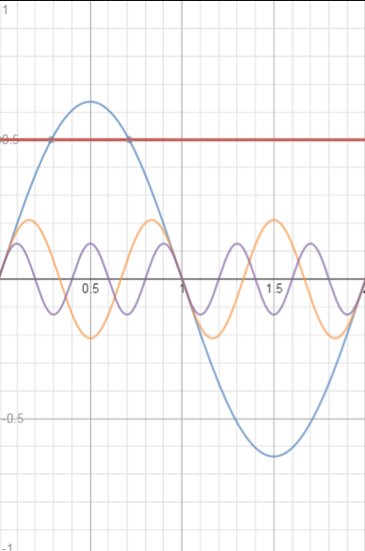
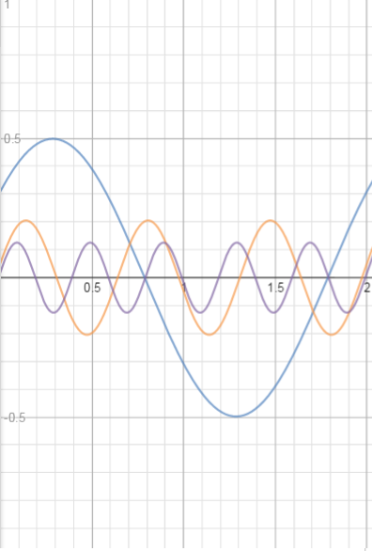
Example

Slide 35
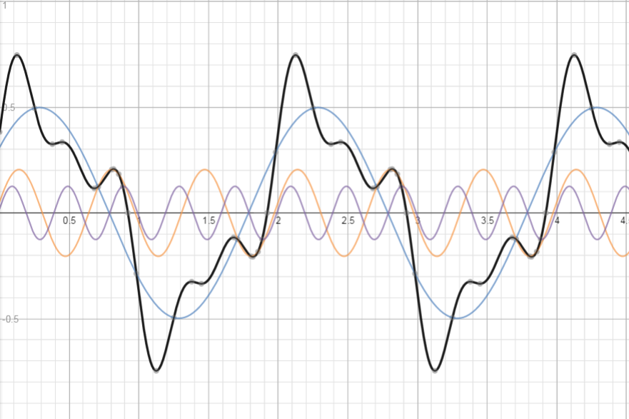
Example

Slide 36
Application:
Resonance

Slide 37
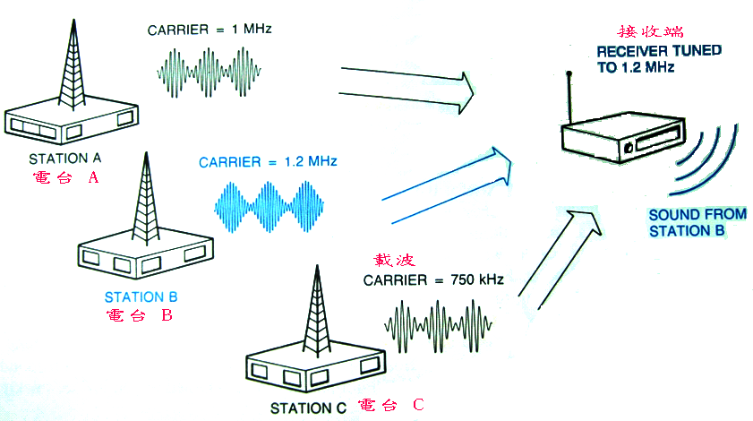

Communication
How to change audio into different frequency?
Notes:
Cell phone is the same

Slide 38
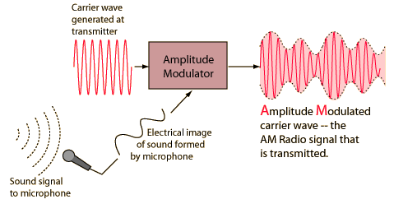
AM
Frequency at f
Frequency close to f

Slide 39
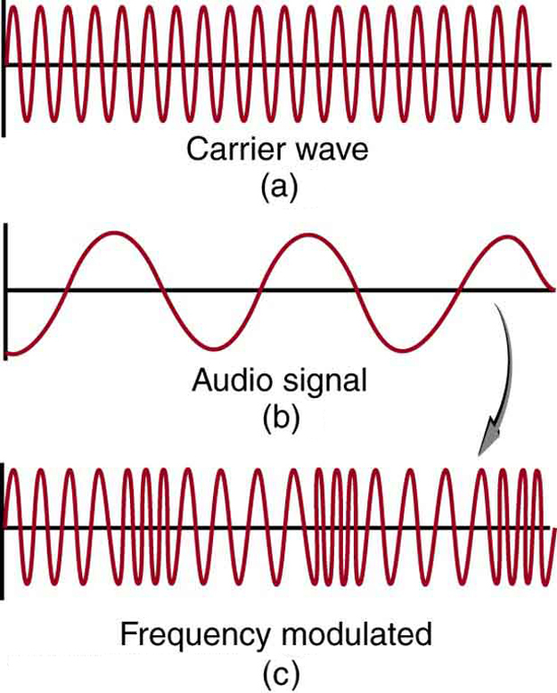
FM
Frequency at f
Frequency close to f

Slide 40
Communication
How to design a circuit that can only receive the signal of a specific frequency?
Notes:
Cell phone is the same

Slide 41
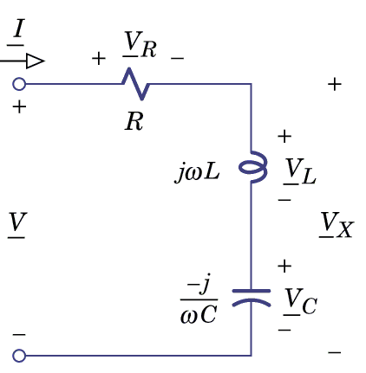
Series RLC

Slide 42
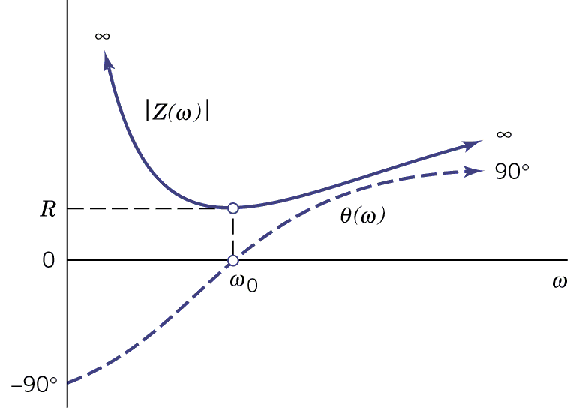
Series RLC

Slide 43
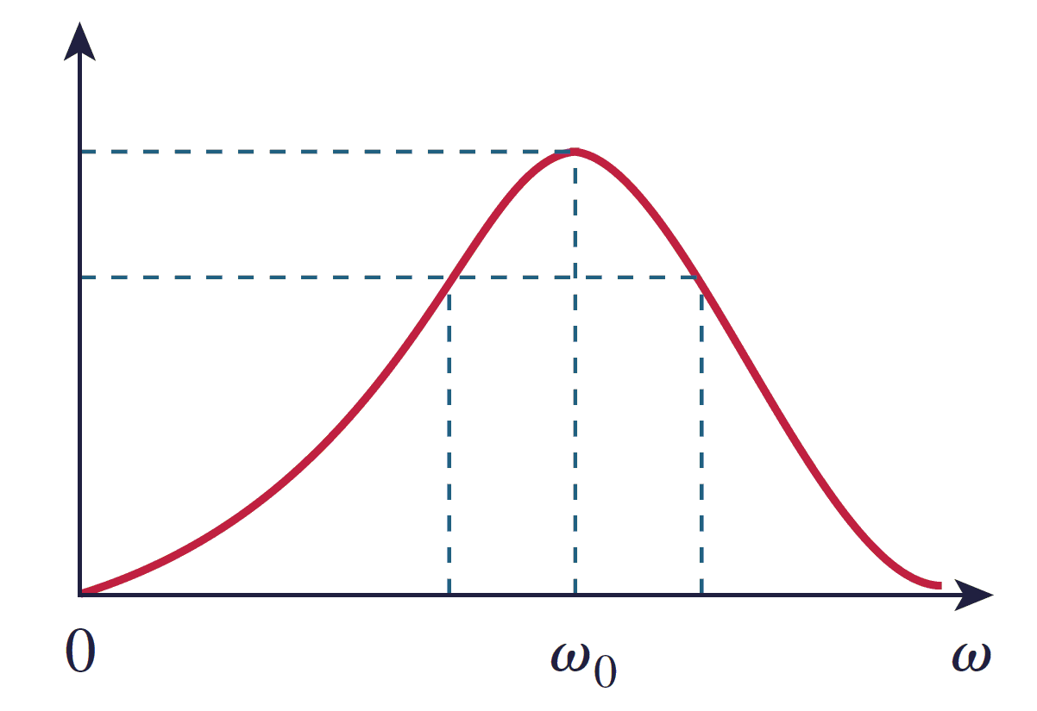
Fix V_{m}
Change ω

Slide 44

Resonance
Antenna
If the frequency of the input signal is close to ω₀
Large current
Otherwise
Like open circuit
Notes:
tuner

Slide 45
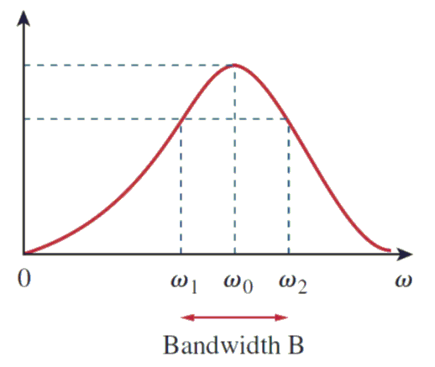
Series RLC - Bandwidth

Slide 46
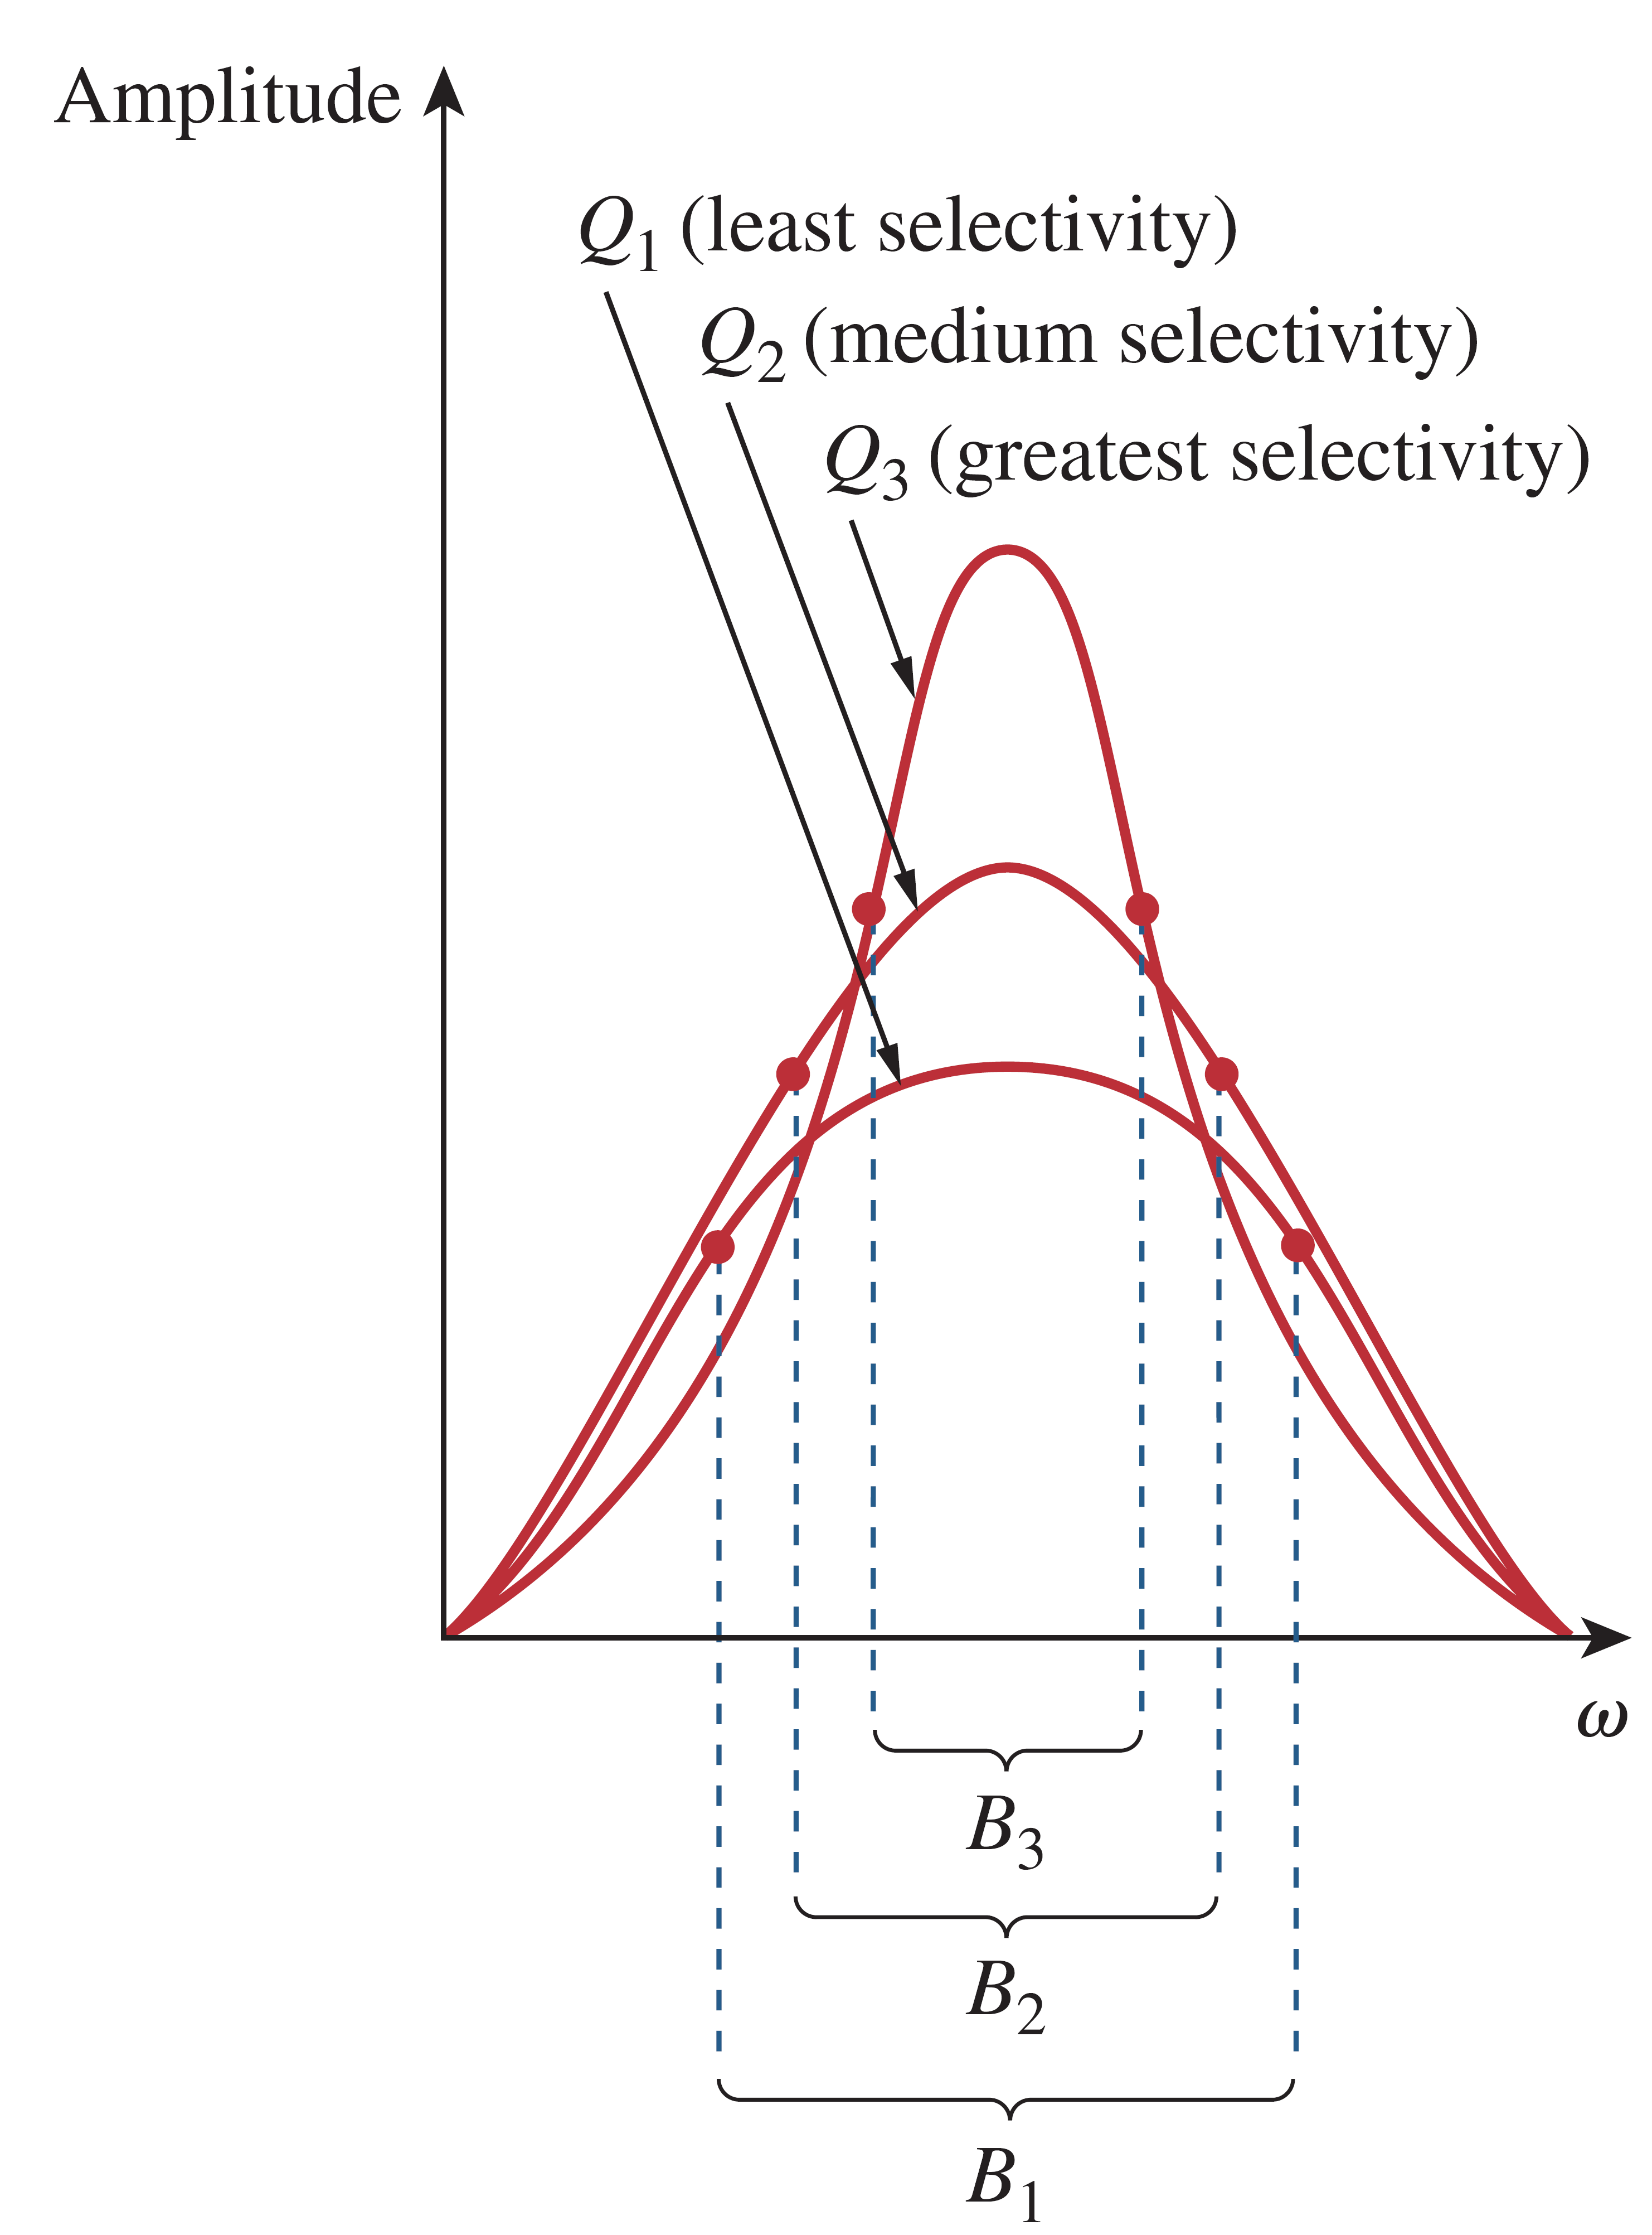
Quality
Using quality factor Q to define the selectivity

Slide 47
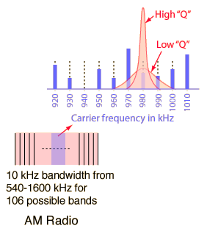
Quality
For radio, cell phone, etc., the quality should be
  1. As high as possible?
  2. As low as possible?
  3. None of the above?

Slide 48
Application:
Oscillator
Notes:
http://faculty.mu.edu.sa/public/uploads/1400394697.1447Ch16%20-%20Oscillators.pdf
http://www.electronics-tutorials.ws/oscillator/rc_oscillator.html
http://www.physics.oregonstate.edu/~tgiebult/COURSES/ph412/Reading/oscillators-1p.pdf

Slide 49
Oscillator
Oscillator (Example 9.7 and 6.10)
  An oscillator is an electric circuit that generate a sinusoidal output with dc supply voltage
  DC to AC
Remote Controller,
Cell phone
Notes:
遙控器

Slide 50
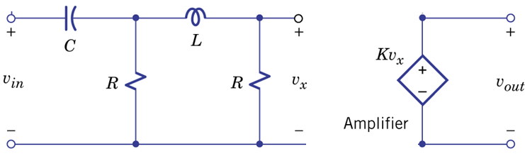
Oscillator - Example 6.10
First Find

Slide 51
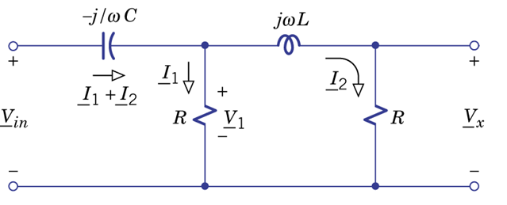
Oscillator - Example 6.10

Slide 52
Oscillator - Example 6.10
If we want v_{in} and v_{x} in phase

Slide 53
Oscillator - Example 6.10
(v_{in} and v_{x} in phase)
If we want v_{in} = v_{out}

Slide 54
Oscillator - Example 6.10
Set
v_{in} = v_{out}
Input:
Use output as input
Notes:
Generate sinusoids without input!
No weaken???
Egg-chicken problem

Slide 55
Oscillator - Example 6.10
Generate sinusoids without input!
Will the oscillation attenuate with time?
Yes.
R dissipate the energy
No.
Who supply the power?
Amplifier
Notes:
No weaken???
Egg-chicken problem

Slide 56
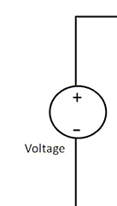
Oscillator - Example 6.10
Battery of controller
TV remote controller
Notes:
We only considers steady state

Slide 57
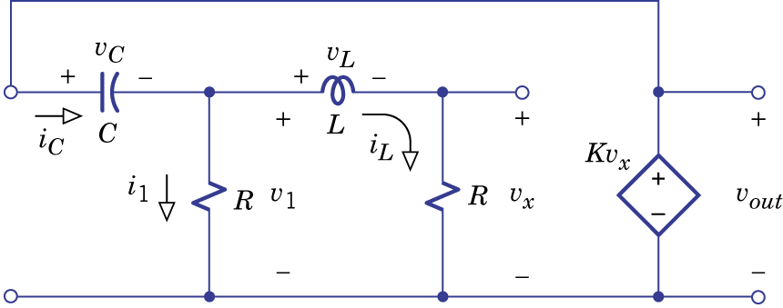
Oscillator - Example 9.7
Set
Undamped

Slide 58
Oscillator - Example 9.7
Amplitude and phase are determined by initial condition

Slide 59
Homework
6.46
6.52
6.44

Slide 60
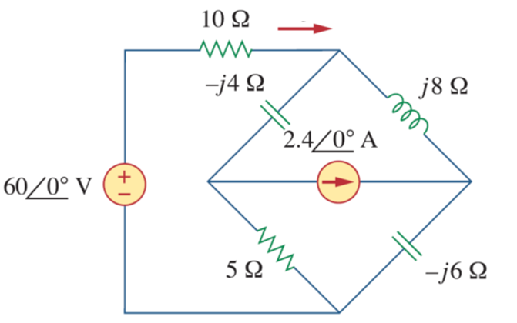

Homework – Mesh Analysis 1
$$find \underline{I}$$
$$\underline{I}$$

Slide 61
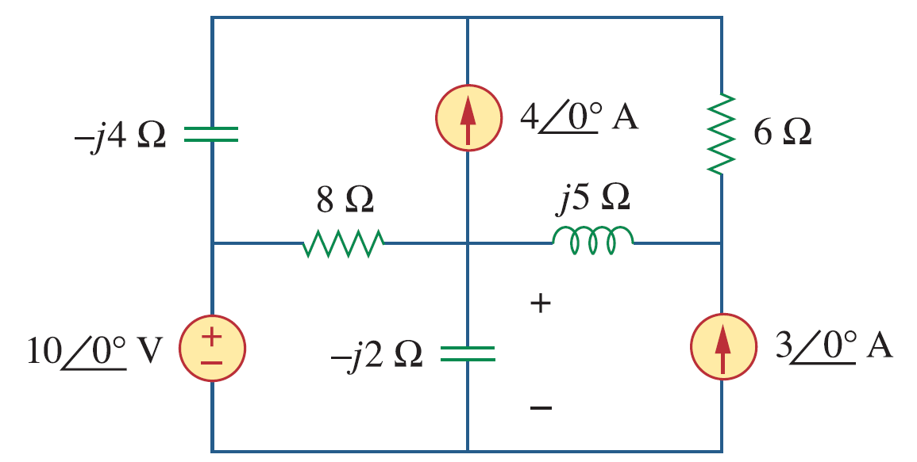


Homework – Mesh Analysis 2
$$find \underline{V}$$
$$\underline{V}$$

Slide 62
Homework – Thevenin 1
Find the Thevenin equivalent of the following network

Slide 63
Homework – Thevenin 2
Find the Thevenin equivalent of the following network

Slide 64
Homework – Superposition 1
(out of the scope) Calculate v_{o}

Slide 65
Homework – Superposition 2
(out of the scope) Calculate v_{o}

Slide 66
Thank you!

Slide 67
Answer
6.46: v2=8cos(5t+53.1。)
6.52:
6.44

Slide 68
Answer – Mesh Analysis 1

Slide 69

Answer – Mesh Analysis 2
$$\underline{V}=$$

Slide 70
Answer – Thevenin 1
Find the Thevenin equivalent of the following network

Slide 71
Answer – Thevenin 2
Find the Thevenin equivalent of the following network

Slide 72
Answer – Superposition 1
Using superposition

Slide 73
Answer – Superposition 2
Using superposition

Slide 74
Acknowledgement
  感謝 陳俞兆(b02)
    在上課時指出投影片中的錯誤
  感謝 趙祐毅(b02)
    在上課時指出投影片中的錯誤
  感謝 林楷恩(b02)
    修正作業的答案

